Slide 1
SmartVote
Team Members:
Qiao Zhang (u)
Kun Liu (u)
Qiao Zhao (u)
Ruiliang Gong (u5083478)

Slide 2

Key Characteristics of current E-Voting Systems
Receipt-based Voting process
Voters use the receipts given by a third-party authority as “passport” to participate in an election.
Centralized Data-storing Architecture
Using a centralized Database to store all Data of an election.
Third Party Supervision
Election must be held and supervised by trusted third parties.
Looks all good?

Slide 3
What could be wrong? Let’s look at it again..
Receipt-based Voting process
Could cause voting under duress – someone knows you have the “passport” to vote
Centralized Data-storing Architecture
Third Party Supervision
Could cause illegal counting process
Could cause vote purchase – receipt could be bought by someone
Could cause receipt lost – peeked and then used by someone OR lost it
Is easy to be tampered
Is easy to be attacked
Is not fault-tolerant
Could cause result changing
Could cause any kind of threat to voters – third parties have access to both receipts, voters’ personal information and the result of all votes

Slide 4
What E-voting System do we need?
A System with:
Better voter Authentication
Non-receipt-based user authentication
Security
No one can falsify votes without getting caught
Anonymity
Other people couldn’t find out how a voter voted
Non-expert Verifiability
Non-expert voters can easily verify their votes has been counted properly.
Free from Coercion
Avoid ‘gun-to-the-head’ situations (impossible)
There is no way that a voter can show to another person how he/she voted
Customizable Voting Rules
More than voting to whom OR “agree or disagree” etc.

Slide 5
Who could need a better E-voting System?
Non-Governmental Organizations (NGOs)
Especially international NGOs
Large Companies, education institutions and other for-profit organizations
For decision making or norms/standards making.
For human resources allocation.
Large Communities
Local, national, international or virtual communities
Governments (perhaps)
A lot of things to concern before adopting E-voting System

Slide 6
SmartVote – A distributed E-voting System applying Blockchain and Smart Contracts

Slide 7
What is Blockchain?
A blockchain is a distributed database serving as a public ledger of data transactions – each participating network node keeps a copy of this ledger and offers its computing power to repeatedly collect, verify and broadcast newly performed transactions, trying to record them as a new block to the end of the blockchain (“mining”).
A blockchain is extremely hard for an attacker to fraudulently modify, unless the attacker has more computing power than the rest of the network combined.

Slide 8
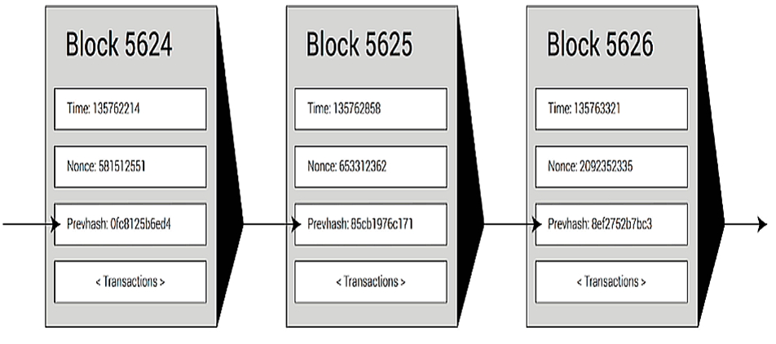
The Structure of A Blockchain - A sequential Distributed Database.
Source: Ethereum whitepaper

Slide 9
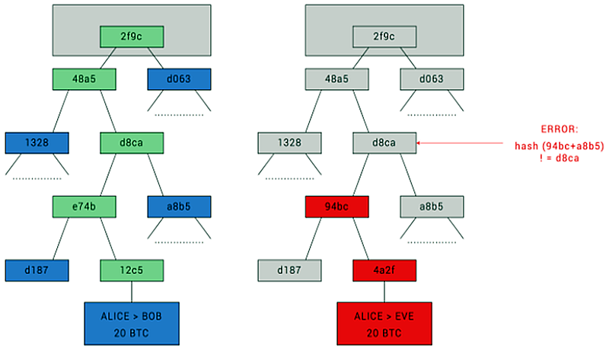
Data structure of Blockchain: Merkle Tree Situation: When someone is trying to tamper the transaction record, it will be detected
Source: Ethereum whitepaper

Slide 10
What are Smart Contracts?
Smart Contracts are:
blockchain housed scripts which are compiled into very low level operation codes and stored in the Blockchain’s data store at a particular address – which is determined when the contracts are compiled and deployed to the blockchain.
When a transaction is sent to that address the distributed virtual machine executes the script’s operation codes and is able to use the data which is sent with the transaction.

Slide 11
Benefits of Using Blockchain and Smart Contracts
Decentralized software – low cost, trustless, fault-tolerance
Security – strong tamper resistance (which could lead to receipt-less)
More complicated use cases – customizable rules for ownership, transaction formats and state transition functions, etc.

Slide 12
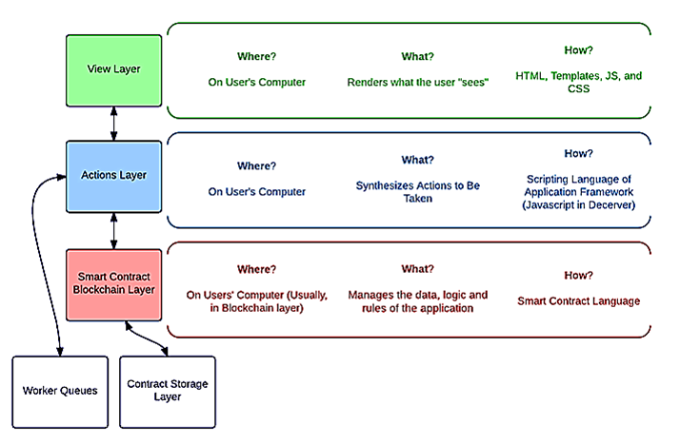
The Architecture of a Dapp (including SmartVote)
Source: Eris Industry Blog

Slide 13
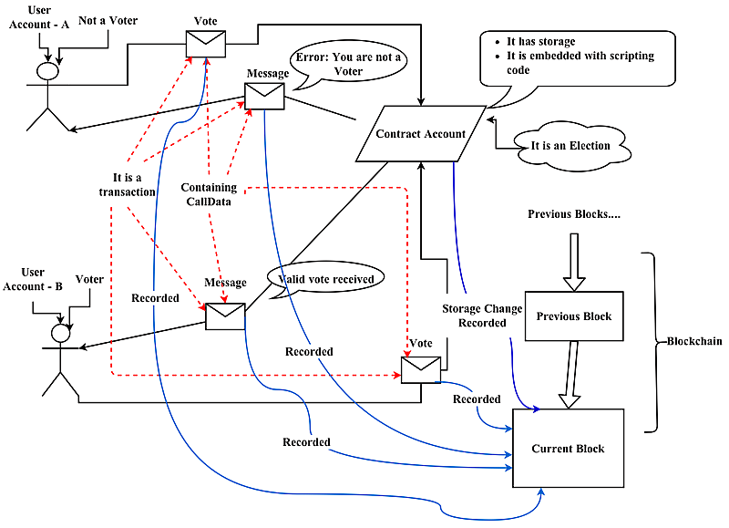
A Simple Voting Process in SmartVote

Slide 14
In Summary
The ultimate goal of SmartVote is:
To build a distributed E-voting system that can provide an anonymity-supporting, verifiable , secure, customizable voting environment integrating with user management and communication modules.
When it is completed, we hope SmartVote can fulfill all the requirements of E-Movment.

